Slide 1
NHS Management
Dylan Jones - COO

Slide 2
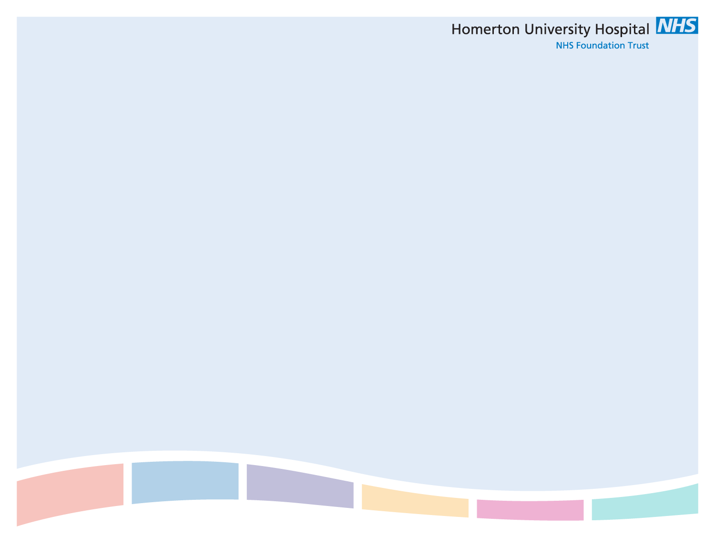
Background
Graduate Training Scheme
Service Manager - Cardiology
General Manager – Medicine
Chief Operating Officer

Slide 3
What do we (try to) manage?
External
  Care Quality Commission
  NHSE/NHSI
  Commissioners
  GPs
  Patients

Slide 4
What do we (try to) manage?
Internal
  Staff
  Money
  Infrastructure
  Performance……
  Board of Directors

Slide 5
How do we do it?
Directorate/Speciality
Division
Executive
Board
The role played by Doctors within these structures remains varied across organisations

Slide 6
Current Themes
Use of Resources
Quality Standards
Quality Improvement
Clinical Variation
Integrated Care

Slide 7
Why do I need you?
Internal Influence
  Length of Stay
  Outpatient Follow Up Rates
  4hr Emergency Care standard
External Influence
  GP Engagement
  Patient Feedback
  Clinical Outcomes

Slide 8
Why you may need me…?
Service Development & Promotion
  ACERS
  NE London Eye Screening
External Environment
  Accreditation
Day to Day Working
  Allergy Unit

Slide 9
Final Thoughts
Challenges of working with Doctors:
Establishing credibility
Making your objectives their objectives
Shared accountability

