Slide 1

Leading an Integrated Respiratory Team
Laura Graham MCSP, MSc, NMP
Respiratory Lead
Respiratory Physiotherapist

Slide 2

Aims
Brief overview of Integrated care
Overview of ACERs
ACERs Respiratory Service
Benefits & Challenges
Patient Outcomes
Recommendations

Slide 3
Integrated Respiratory Care
“Integrated respiratory care is patient-centered, proactive and coordinated care delivered through clinical leadership and a multidisciplinary ‘team without walls”
Patel I, 2014

Slide 4
Integrated Respiratory Care Aims to
“Best possible care, delivered by the most suitable individual or service, in the most suitable setting” (BTS 2014)
One patient pathway – across all healthcare settings
Personalised Care
Proactive not reactive
Partnership – between patients and services
Aimed at improving patient outcomes
Available 7 days a week

Slide 5
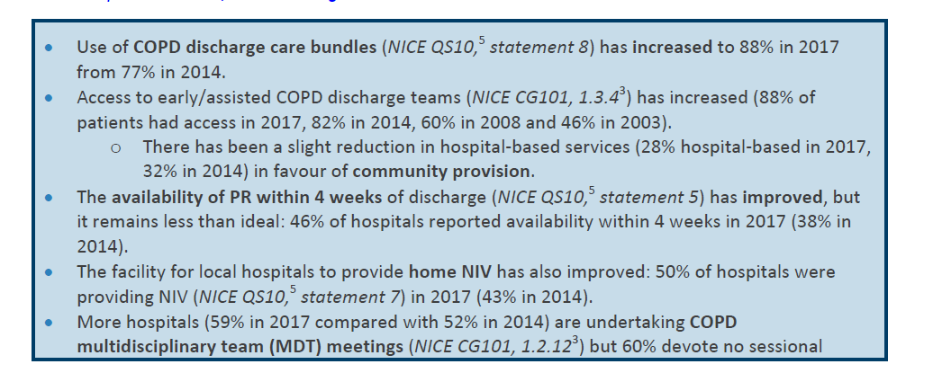
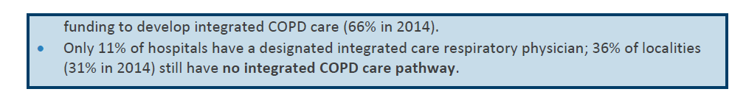
Integrated Care (2018)
Notes:
2017 Community Provision had improved – shift from hospital based care to the community
However 36% of localities still don’t have an integrated COPD care pathway.
Lots still to be done

Slide 7


Slide 8
Service Development
Established in 2009 as a COPD admission avoidance service:
2012 – Home Oxygen Service
2013 – Community Pulmonary & Heart Failure Rehab
2015 – Clinical Psychology
2016 – Community Heart failure & Cardiac Rehab
2017 – Commissioned for Asthma & other chronic respiratory diseases

Slide 9
CCG block contract – Community Health Services
Separate Cardiac & Respiratory Pathways
18 years old +
Live or have a C&H GP
Based Homerton Hospital & St Leonards Hospital
2009 - 8 staff
2019 – 31 staff
Mobile working & paperless

Slide 10
Adult Cardiorespiratory Enhanced and Responsive Service
Consultant & Nurse Consultant Lead
Respiratory Team | Cardiac Team
Dedicated Clinical Lead - Physiotherapist | Dedicated Clinical Lead - Nurse
Physiotherapists, Nurses, Rehab Assistant, Admin | Nurses and Assistant practitioner, Apprentice, Admin
7 Day Service/ 24hr Advice line | 5 Day Service
Cardiorespiratory Rehab – 4 Venues | Cardiorespiratory Rehab – 2 venues
Integrated ACERs Psychology service | Linked to IAPT service – dedicated ACERs team
Hospital at Home, Pulmonary Rehab, Integrated breathlessness rehab, Oxygen Service, Case management, Respiratory Physiotherapy, Palliative care | Case Management, support following admission, GP clinics, post discharge clinic Inpatient review, Cardiac Rehab
Notes:
Commissioned by CCG

Slide 11

Home Oxygen assessment and review
Smoking Cessation
Respiratory Nursing
Inpatient Cardiac Nursing
Respiratory Physiotherapy
Discharge bundles
Integrated Cardiorespiratory Rehab
Early Supportive Discharge
Integrated End of Life Support
Specialist Heart Failure Nurse Clinic
Clinical Psychology & CBT therapy
Admission Avoidance
Health promotion/
Support & education
Non medical Prescribing

Slide 12
What ACERs don’t currently do
Diagnostic Spirometry
Home NIV
Rapid Response for Heart Failure
Home IV Management – Diuretic's or Abx
Nebulised Abx therapy

Slide 13
Respiratory Team

Slide 14
Commissioned for:
KPI | Target | Actual 2018/9
Referrals (not PR) | 1800 | 3883
PR Referrals | 200 | 528
A&E Contacts | 70 | 314
Patient experience | Sample of 50 | 50+
COPD Assessment Test Scores – HAH | 75% of people improved | 83% -13.5 improvement
Reduction in A&E attendances for COPD
Reduction in emergency admissions for COPD
Reduction in readmissions
Reduction in LOS for COPD patients

Slide 15
Other KPIs
Patient demographics
Waiting times
Patient Reported Outcomes
Complaints

Slide 16
Hospital at Home
Any chronic respiratory disease
Very inclusive – referral from any stakeholder
Contact within 4 hours, Seen within 24hours
  Holistic Respiratory assessment/management
  Link between Primary and Secondary Care
  Medication management
  Airway clearance
  Nebulised therapy
  CBGs/Bloods/blood glucose monitoring/Sputum Culture
  FeNO monitoring
  Non-medical prescribing
  Referrals to other services
  Refer for further investigations/Admit patient

Slide 17
Respiratory In-reach
Review in ED or ACU – Early Supported Discharge
Monitoring
Oxygen Therapy review
Discharge Bundles
Smoking Cessation
Post Exacerbation Pulmonary Rehab
Training/Support

Slide 18
Case management clinics
Respiratory Case management
Asthma
Chronic Cough/Dysfunctional Breathing
Bronchiectasis
Recovery Clinic
North London Action for the Homeless
Palliative Care/breathlessness management

Slide 19
Typical Clinic Referral
Confirm Diagnosis – where practice is unsure
Medication optimisation
Symptom management: cough/breathlessness
Frequent attenders
Frequent Rescue Medication
Self management/Education Required

Slide 20
Home Oxygen Assessment & Review
Home visits & Clinics
Ambulatory oxygen assessments
Yearly reviews
Monitoring usage
Optimising equipment
Removal – often very difficult
Actively involved in Pan London Network

Slide 21
Cardiorespiratory Rehabilitation
Pulmonary Rehabilitation
Integrated Breathlessness Rehabilitation
Lower Level Rehab
Cardiac Rehab
Prehab Education
Phase 4 integrated Maintenance programme – Cardiorespiratory
National Accreditation Scheme Engagement

Slide 22
Education
Students
  Nursing
  Physiotherapy
  Medical
Shadowing
  Primary care
  Secondary care
Training
  Secondary Care
  Primary Care

Slide 23
Respiratory Lead Role
50% Clinical, 50% non-clinical
Hold the largest case load in team
Non-medical prescriber
Coordination of service – staffing and provision
Mentoring and supervision
Expert Clinical Support internally and externally
Quality Improvement, Service Expansion, Development
Integration between provider and commissioners
Involvement on a number of Trust Boards/Groups
Involvement in External Networks
Promotion to wider Stakeholders/networking
Complaints and investigations
Research & Audit

Slide 24
Respiratory Clinicians
Blurring of lines
Extended Scope
Interchangeable roles
Multi-disciplinary supervision/appraisal
Shared vision
Collaboration
Multidisciplinary Training

Slide 25
Why does it work?
ACERs is a Brand
Shared Team Values
Patient Trust
Trust between team members
Trust & Support Secondary and Primary Care
Flexible team members
Available clinical support
Collaboration between provider and commissioner

Slide 26
Benefits of an integrated ACERs service
Shared values
Patient Centred Holistic Care
Improved Care Coordination
Reduced duplication
Consistent care
Improved patient flow
High patient satisfaction
Sustainability of the service

Slide 27

Retrospective study pre (2007-11) and post (2011-14) ACERs
Results: Integration works!
30% reduction in no of hospital bed days (p<0.05)
Increase in short stay (0-1days) (p<0.0001)
More patients dying out of hospital (p=0.00015)
83% of patients had COPD management plans
£££££ = cost neutral
Notes:
Pre ACERs, 2007- 2011 and post ACERS 2011 to 2014.
Study by my colleagues in City and Hackney regarding ACERs
Improved coding as well – as per TH linked to financial incentives
Bed days decreased as we were turning patients around quicker. Reduction in bed days by just over 600 bed days per year, LOS decreased but wasn’t significant.
No difference in readmission rates pre/post - ?sickest patients still coming in, those in resp failure, admissions are rising nationally
Also looked at Homerton Hospital only admissions – reduced from 1.07 to 0.99, small and non-significant – however 57% of patients admitted were unknown to ACERS prior to admission. Still need to work on early diagnosis
COPD management PLANs – 83% of patients post ACERs had management PLANs in City and Hackney
ACERs readmission at 30 days 17.3% (lower than National)

Slide 28
Patient Outcomes

Slide 29
They have kept me out of hospital many times
I feel safe and secure knowing that ACERS is looking after me
Hospital at home is the best way to treat patients
visits and telephone calls frequent which is very reassuring.
Highly recommended especially if timely access to GP difficult
Fast to respond

Slide 30
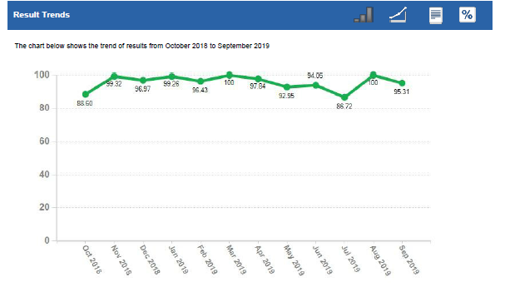
Patient Satisfaction

Slide 31
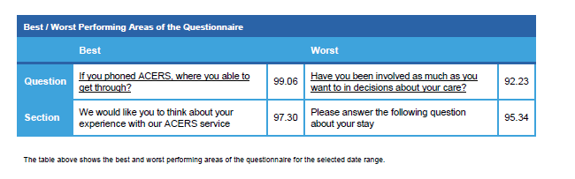
Patient Feedback

Slide 32
Patient Experience Measures
“The Patient’s perception of the interaction of values, goals and desires and encompasses more than satisfaction alone”
(Jason, 2014, Robert and Cornwell, 2013)
Key to quality improvement (De-Silva, 2013).
A driver for improved effectiveness and safety (The National COPD Audit programme; Skipper et al., 2014).

Slide 33
Measuring Patient Experience
COPD PREM 9
Measures experience of living with COPD
9 items
Higher scores = poorer experience
Does not correlate with symptom burden
Notes:
Sensitive to PR
Our current data suggests not responsive to Case Management
HAH – collating data

Slide 34
Challenges

Slide 35
Challenges
Large expanding Service
Infrastructure differences
Team/Service logistics
Staff retention – untrained workforce
Commissioning - expectation
Patient and referrer expectation
Space – clinics/rehab groups/office
IT – work on 3 systems
Maintaining Staff Satisfaction

Slide 36
Challenge of delivering integrated Care
Aging population – Increasing demand
NHS Long-term Plan – Increasing Demand
Austerity– Increasing demand
Sustainability of the workforce
Metrics differ – RightCare/SUS/NACAP

Slide 37
Future of Respiratory Care
NHS Long-term Plan
Programme Delivery Plans – National/regional/STP/local delivery groups
Neighbourhoods and Primary Care Networks
Population Based Healthcare
Recruitment and Retention of Services
Digital Health – collaborative & appropriate
Notes:
PCN – commissioning
Neighbourhoods – prevention and promotion of healthy living
Both delivering personalised care

Slide 38
What can you do as a Future Consultant
Get to know your community teams
Encourage them to spend time you with as well
Go on a home visit
Attend a Pulmonary Rehab Class
Don’t underestimate your influence
Be Available
Communication is key

Slide 39
Conclusion
Integrated Care is effective
Cost effective if done well
Improves patient flow through the pathway
If done well = high patient & staff satisfaction
Balancing all the variables challenging
The future, but uncertain

Slide 40

Thank you
@ACERsHomerton
@goldens2482

Slide 41


